Slide 1

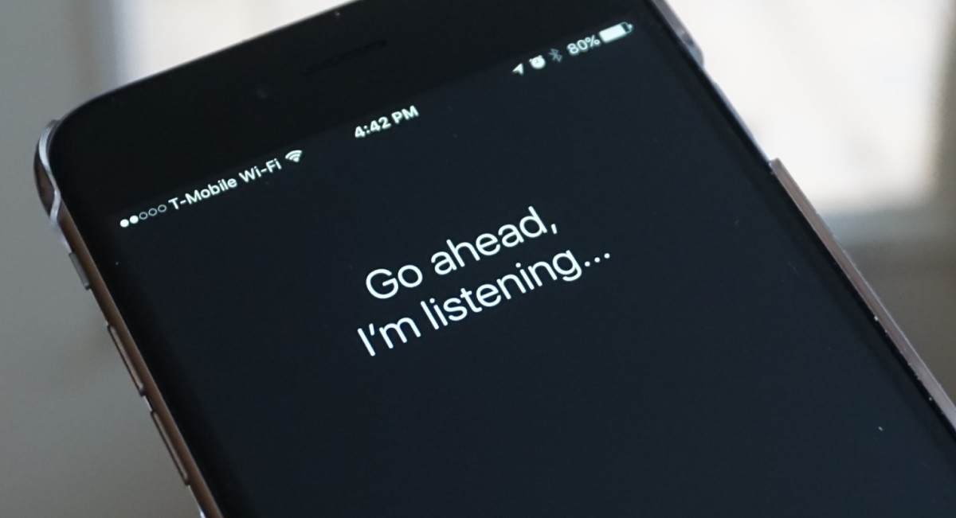
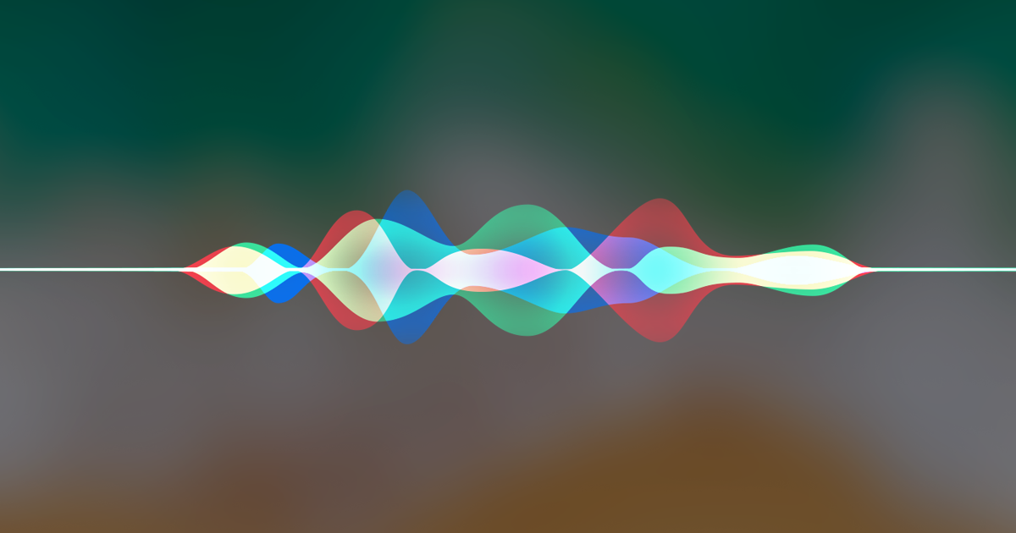
ARTHUR MURILLO
SIRI- A personal digital assistant
What is it, exactly?
What can it be used for?
Why is it important today?
How did we manage before it was released ?
Friday, the 21st of September 2018
SEMESTER 1

